Slide 1

Technology in Action
Alan Evans • Kendall Martin
Mary Anne Poatsy
Eleventh Edition
Notes:
Welcome to Chapter 4: Application Software: Programs That Let You Work and Play

Slide 2
Technology in Action
Chapter 4
Application Software: Programs That Let You Work and Play
Notes:
This chapter discusses the kinds of software you can use to perform a variety of tasks, from simple word processing to digital image editing. We’ll also discuss how you can buy software, what the different versions of software mean, how you can legally get free software from the web, and how you install and uninstall software safely on your system.

Slide 3
Chapter Topics
The Nuts and Bolts of Software
Productivity and Business Software
Multimedia and Entertainment Software
Managing Your Software
Notes:
Topics in this chapter include:
The nuts and bolts of software
Productivity and business software
Multimedia and entertainment software
Managing your software

Slide 4
The Nuts and Bolts of Software
Software
Two basic types of software
Notes:
Software refers to a set of instructions that tells the computer what to do. An instruction set, called a program, provides a means for us to interact with and use a computer.
Your computer has two basic types of software: application software and system software.
Application software is the software you use to do tasks at home, school, and work.
System software includes software that helps run the computer and coordinate instructions between application software and the computer’s hardware devices. System software includes the operating system and utility programs.

Slide 5
The Nuts and Bolts of Software (cont.)
Preinstalled software
Installed software
Proprietary (or commercial) software
Open source software
Notes:
Virtually every new computer comes with software preinstalled, including an operating system and some application software. If you need to add other software you’ll need either to install the software yourself or to access it from the web. There are two types of software you can install on your computer:
Proprietary (or commercial) software is applications you buy, such as the Microsoft Office applications you’re probably familiar with.
Open source software is free software that is available with few licensing and copyright restrictions.

Slide 6
The Nuts and Bolts of Software (cont.)
Software as a Service (SaaS)
Web-based applications
Collaborate online
Notes:
Another way to obtain software is through Software as a Service (SaaS), in which the vendor hosts the software online and you access and use the software over the Internet without having to install it on your computer. With these web-based applications, you can collaborate online with others, avoiding the coordination mess that often occurs when transferring documents via e-mail.
Although many web-based applications are not as fully featured as their installable counterparts, most work with files from other applications.

Slide 7
Productivity and Business Software
Productivity software
Word processing
Spreadsheet
Presentation
Database
Personal information manager
Notes:
Productivity software includes programs that let you perform various tasks required at home, school, and business and includes word processing, spreadsheet, presentation, database, and personal information manager programs.

Slide 8
Productivity and Business Software: Buying Productivity Software
Software suite
Microsoft Office
Apache OpenOffice
Apple iWork
Notes:
For proprietary software, it’s cheaper to buy a software suite than to buy each program individually. Software suites are available for all types of software, including productivity, graphics, virus protection, and others.
Microsoft Office is the standard proprietary software suite for Windows. A version is available for Apple computers.
Apache OpenOffice is an open source productivity suite that provides functionality similar to that of Microsoft Office. You can download the installation file you’ll need to run OpenOffice at openoffice.org.
Apple iWork is a productivity suite made especially for Apple computers.

Slide 9
Productivity and Business Software: Buying Productivity Software
Web-based productivity suites
Microsoft Office 365
Google Docs
Share common features, toolbars, and menus
Notes:
Microsoft Office Web Apps and Google Docs are examples of web-based productivity suites. Microsoft Office Web Apps are part of Microsoft Office 365 and are online versions of Word, Excel, PowerPoint, and OneNote but with less functionality than the installed versions.
Google Docs (docs.google.com) includes word processing, spreadsheet, and presentation functionality, as well as forms and drawing applications. If you’re looking for basic productivity software that you can access from any computer, Google Docs is sufficient.
The individual programs within a suite work well together because they share common features, toolbars, and menus

Slide 10
Productivity and Business Software: Word Processing Software
Create and edit documents
Research papers
Class notes
Résumés
Microsoft Word
Writer
Notes:
You’ve probably used word processing software to create and edit documents. Microsoft Word is the most popular word processing program that you can buy and install on your computer.
If you are looking for a more affordable alternative, you might want to try an open source alternative such as Writer, a word processing program from the Apache OpenOffice suite (openoffice.org). When saving a document in Writer, the default file format has an OpenDocument file (.odt) extension. By using the Save As command, you can save files in other formats, such as .doc for Word.

Slide 11
Productivity and Business Software: Word Processing Software (cont.)
Basic word processing tools
Special tools
Notes:
You’re probably familiar with the basic tools of word processing software, such as the spelling and grammar checking tools, the thesaurus, and the find-and-replace tool.
But did you know you can translate words or phrases into another language or automatically correct your spelling as you type? You can also automatically summarize key points in a text document, add bibliographical references, and include illustrations with different picture styles.

Slide 12
Productivity and Business Software: Word Processing Software (cont.)
Word processing software
Notes:
With word processing software, you can easily change fonts, font styles, and sizes; add colors to text; adjust margins; add borders to portions of text or to entire pages; insert bulleted and numbered lists; and organize your text into columns.
You can also insert pictures from your own files or from a gallery of images and graphics, such as clip art and SmartArt, which are included with the software.
You can also enhance the look of your document by creating an interesting background or by adding a “theme” of coordinated colors and styles.

Slide 13
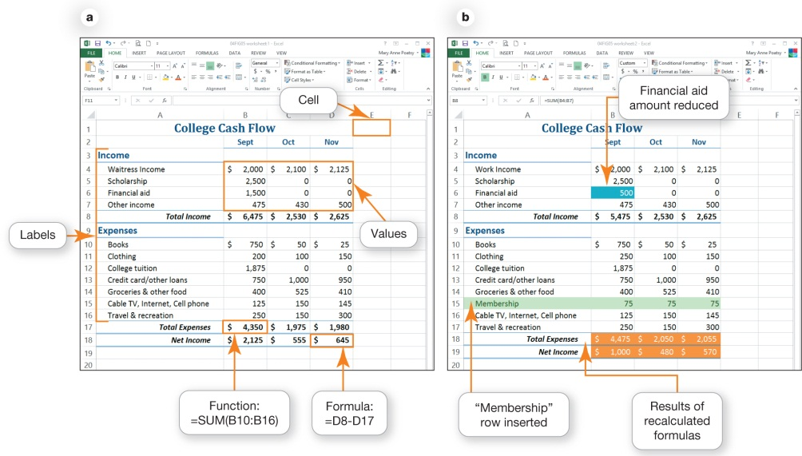
Productivity and Business Software: Spreadsheet Software
Performs calculations and numerical analyses
Examples
Microsoft Excel
OpenOffice Calc
Notes:
Spreadsheet software lets you make calculations and perform numerical analyses. You can use it to track your expenses or create a simple budget.
Microsoft Excel and Apache OpenOffice Calc are two examples of spreadsheet software. One benefit of spreadsheet software is that it can automatically recalculate all formulas and functions in a spreadsheet when values for some of the inputs change.
Automatic recalculations show the effects different options have on a spreadsheet, so you can quickly test different assumptions. This is called what-if analysis.
Many spreadsheet applications have limited database capabilities to sort, filter, and group data.

Slide 14
Productivity and Business Software: Spreadsheet Software (cont.)
Worksheet
Types of data
Text
Values and dates
Formulas
Functions
Notes:
The basic element in a spreadsheet program is the worksheet, which is a grid consisting of columns and rows. The columns and rows form individual boxes called cells.
You can enter several types of data into a cell.
Text: Any combination of letters, numbers, symbols, and spaces.
Values and dates: Numerical data that represent a quantity or a date/time and is often the basis for calculations
Formulas: Equations that use addition, subtraction, multiplication, and division operators, as well as values and cell references.
Functions: Formulas that are preprogrammed into the spreadsheet software.

Slide 15
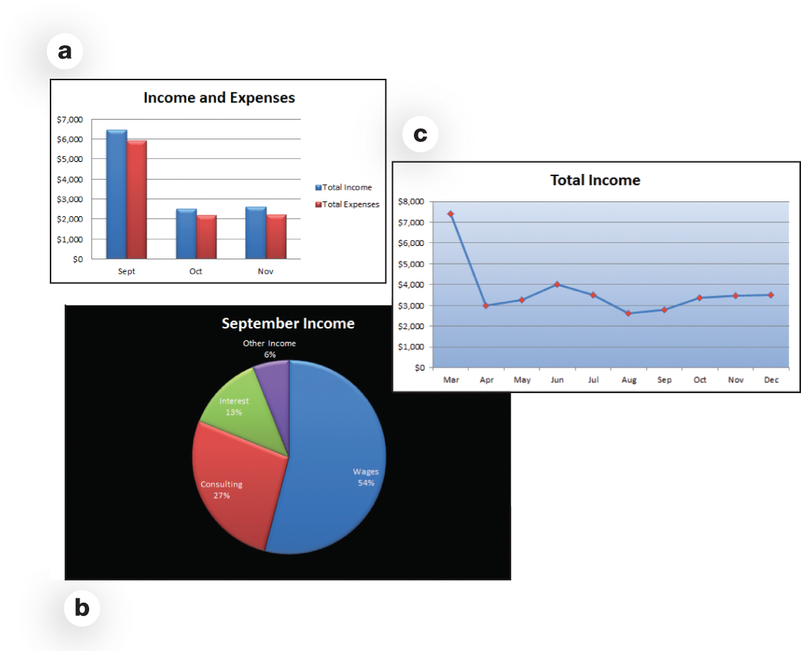
Productivity and Business Software: Spreadsheet Software (cont.)
Create charts
Notes:
Most spreadsheet applications let you create a variety of charts, including basic column charts, pie charts, and line charts, with or without 3-D effects. In addition to these basic charts, you can make stock charts (for investment analysis) and scatter charts (for statistical analysis), or create custom charts.

Slide 16
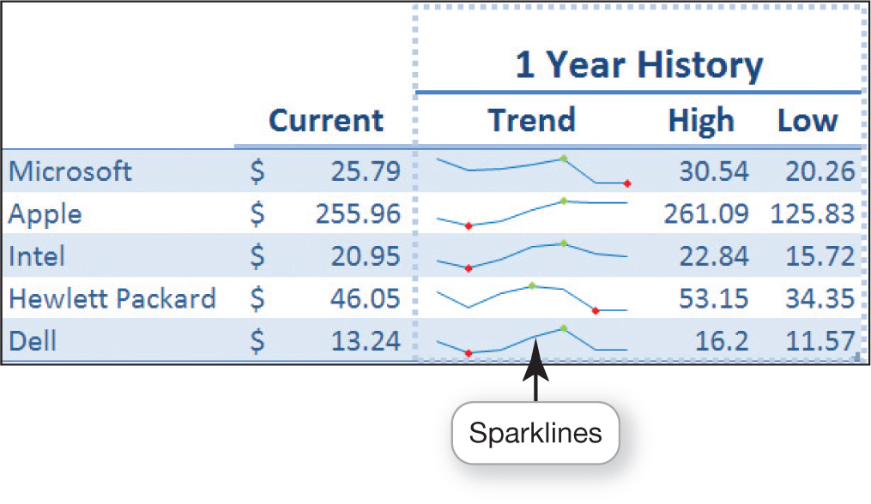
Productivity and Business Software: Spreadsheet Software (cont.)
Sparklines
Notes:
A newer feature in Excel is sparklines—small charts that fit into a single cell and make it easy to show data trends.

Slide 17
Productivity and Business Software: Presentation Software
Slide shows
Example
Microsoft PowerPoint
Capabilities in PowerPoint
Embed online videos
Add effects
Trim video clips
Notes:
You’ve no doubt sat through presentations where the speaker used presentation software such as Microsoft PowerPoint to create a slide show. Because these applications are simple to use, you can produce high-quality presentations without a lot of training.
With some of the capabilities in PowerPoint, you can embed online videos, add effects, and even trim video clips without the need for a separate video-editing program.

Slide 18
Productivity and Business Software: Presentation Software (cont.)
Tips for designing good presentations
Be careful with color
Use bullets for key points
Use images
Consider font size and style
Keep animation and background audio to a minimum
Notes:
Here are some tips for designing presentations :
Be careful with color: Choose a dark text on a light background or light text on a dark background.
Use bullets for key points: Limit the number of bullets per slide to four to six. Avoid full sentences and paragraphs.
Use images: Images can convey a thought or illustrate a point.
Consider font size and style: Keep the font size large enough to read from the back of the room. Avoid fancy font styles. Use only one or two font styles.
Keep animation and/or background audio to a minimum: They can be distracting.

Slide 19
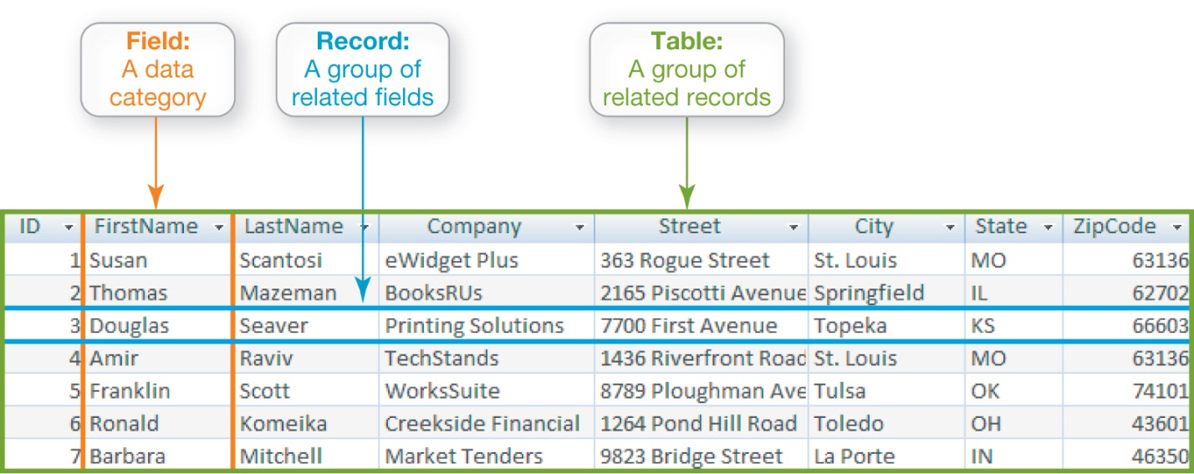
Productivity and Business Software: Database Software
Store and organize data
Track
Products, clients, invoices, and personnel information
Notes:
Database software such as Oracle, MySQL, and Microsoft Access are powerful applications that let you store and organize data.
Traditional databases are organized into fields, records, and tables.
Businesses like Amazon, iTunes, Craigslist, and Pandora all rely on databases to keep track of information.
Some of that information is available to a home computer user. At Amazon.com, you can access the history of all purchases you’ve ever made on the site. FedEx, UPS, and other shipping companies also let you search their online databases for tracking numbers, allowing you to get instant information on the status of your packages.

Slide 20
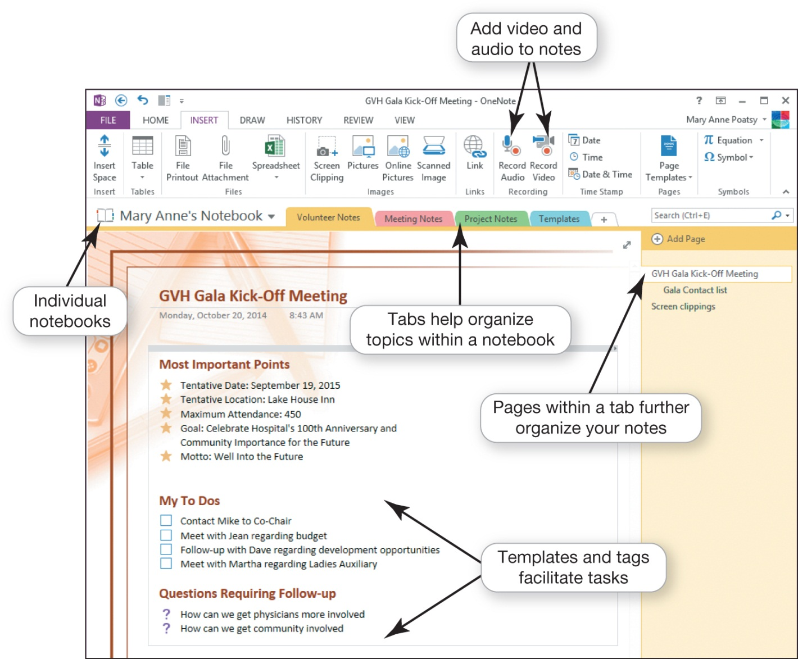
Productivity and Business Software: Note-taking Software
Notes:
Microsoft OneNote is a popular note-taking and organizational tool you can use for research, brainstorming, collaboration, and organization.
You can organize notes into tabbed sections and you can access it from other Microsoft Office applications.
You can add audio or video recordings to OneNote, and you can search for a term across all the digital notebooks.
Several very good free online note-taking options available. Evernote (evernote.com) lets you take notes via the web, your phone, or your computer and then sync your notes between your devices. You can share your notes with other Evernote users for easy collaboration.

Slide 21
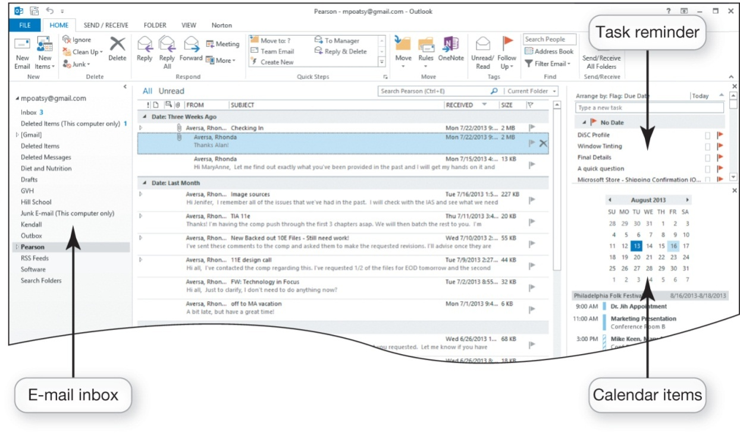
Productivity and Business Software: Personal Information Manager Software
Manage e-mail, contacts, calendars, and tasks
Example-Microsoft Outlook
Notes:
Most productivity suites contain some form of personal information manager (PIM) software to help you manage e-mail, contacts, calendars, and tasks in one place. Microsoft Outlook is the most widely used PIM program.
If you share a network at home or at work and are using the same PIM software as others on a common network, a PIM program simplifies sharing calendars and scheduling meetings.

Slide 22
Productivity and Business Software: Personal Information Manager Software (cont.)
Web-based PIMs
Yahoo!
Google
Other options
Toodledo
OmniFocus
Notes:
Many web-based e-mail clients, such as Yahoo! and Google, also include coordinating calendars and contacts similar to Microsoft Outlook. Yahoo! includes Notepad for jotting down notes and tasks. Google’s calendar and contacts sync with Outlook so you can access your Outlook calendar information by logging into Google.
There are a wide variety of other to-do lists and simple organizers that work with all your mobile and computing devices. Toodledo (toodledo.com) is a free program that coordinates well with Microsoft Outlook, and OmniFocus (omnifocus.com) is a more full-featured option for Mac devices.

Slide 23
Productivity and Business Software: Microsoft Office Productivity Software Features
Tools to increase efficiency
Wizards
Templates
Macros
Notes:
Whether you are working on a word processing document, spreadsheet, database, or slide presentation, you can make use of several tools to increase your efficiency:
A wizard walks you through the steps necessary to complete a complicated task.
A template is a predesigned form. They provide the basic structure for a particular kind of document, spreadsheet, or presentation.
A macro is a small program that groups a series of commands so that they will run as a single command. Macros are best used to automate a routine task or a complex series of commands that must be run frequently.

Slide 24
Productivity and Business Software: Personal Financial Software
Financial planning software
Manage daily finances
Electronic checkbook registers
Automatic bill payment tools
Examples
Quicken and Mint: market leaders
Notes:
Financial planning software helps manage daily finances.
Financial planning programs include electronic checkbook registers and automatic bill payment tools. You can make recurring monthly payments. The software records all transactions, including online payments. You can assign categories to each transaction and then use these categories to create budgets and analyze your spending patterns.
Intuit’s installed and web-based products, Quicken and Mint (mint.com) are the market leaders in financial planning software. With Mint, you can monitor and update your finances from any computer with a private and secure setting. You can also access Mint on a smartphone and tablet.

Slide 25
Productivity and Business Software: Personal Financial Software (cont.)
Tax preparation software
Examples
Intuit TurboTax
H&R Block at Home
Notes:
Tax preparation software such as Intuit Turbo Tax and H&R Block at Home let you prepare your state and federal taxes on your own instead of hiring a professional.
Some financial planning applications also coordinate with tax preparation software. Both Quicken and Mint, for example, integrate seamlessly with TurboTax, so you never have to go through your debit card statements and bills to find tax deductions, tax-related income, or expenses.

Slide 26
Productivity and Business Software: Small Business Software
Accounting software
Track accounts receivable and accounts payable
Inventory management, payroll, and billing
Examples
Intuit QuickBooks
Sage Peachtree
Notes:
Accounting software helps small business owners manage their finances more efficiently by providing tools for tracking accounts receivable and accounts payable. In addition, these applications offer inventory management, payroll, and billing tools.
Examples of accounting applications are Intuit QuickBooks and Sage Peachtree. Both programs include templates for invoices, statements, and financial reports so that small business owners can create common forms and reports.

Slide 27
Productivity and Business Software: Small Business Software (cont.)
Desktop publishing (DTP) software
Design books and publications
Examples
Microsoft Publisher
QuarkXPress
Adobe InDesign
Notes:
If your business requires newsletters, catalogs, annual reports, or other large, complicated publications, consider using desktop publishing (DTP) software. Although many word processing applications include some of the features that are hallmark of desktop publishing, specialized DTP software such as Microsoft Publisher, QuarkXPress, and Adobe InDesign allows professionals to design books and other publications that require complex layouts.

Slide 28
Productivity and Business Software: Small Business Software (cont.)
Web page—authoring software
Design web pages
Examples
Microsoft Expression Web
Adobe Dreamweaver
Notes:
Web page-authoring software allows even the novice to design interesting and interactive web pages without knowing any HTML code. Web page-authoring applications often include wizards, templates, and reference materials to help novices complete most web page authoring tasks.
Microsoft Expression Web and Adobe Dreamweaver are two programs that both professionals and casual web page designers use.

Slide 29
Productivity and Business Software: Software for Large and Specialized Businesses
Specialized programs
Project management
Customer relationship management (CRM)
Enterprise resource planning (ERP)
E-commerce
Marketing and sales
Finance
Point of sale
Security
Notes:
There is an application for almost every aspect of business. There are specialized programs for project management software, customer relationship management (CRM), enterprise resource planning (ERP), e-commerce, marketing and sales, finance, point of sale, security, networking, data management, and human resources.

Slide 30
Productivity and Business Software: Software for Large and Specialized Businesses (cont.)
Specialized programs (cont.)
Security
Networking
Data management
Human Resources
Vertical market software
Designed for a specific industry
Notes:
Some applications are tailored to the specific needs of a particular company or industry.
Software designed for a specific industry, such as property management software for real estate professionals, is called vertical market software.

Slide 31
Productivity and Business Software: Software for Large and Specialized Businesses (cont.)
Computer-aided design (CAD)
Automated designs, technical drawings, and 3-D model visualizations
AutoCad by Autodesk
Notes:
Engineers use computer-aided design (CAD) programs such as Autodesk’s AutoCAD to create automated designs, technical drawings, and 3-D model visualizations.

Slide 32
Productivity and Business Software: Software for Large and Specialized Businesses (cont.)
Applications for CAD software
Virtual models
3-D models
GPS services
Create anatomically accurate solid models of the human body
Notes:
Here are some cool applications for CAD software:
Architects use CAD software to build virtual models of their plans.
Engineers use CAD software to design everything from factory components to bridges. The 3-D nature of these programs lets engineers rotate their models and adjust their design if necessary, eliminating costly building errors.
CAD software also is used in conjunction with GPS devices for accurate placement of fiber optic networks around the country.
The medical engineering community uses CAD software to create anatomically accurate solid models of the human body, developing medical implants quickly and accurately.

Slide 33
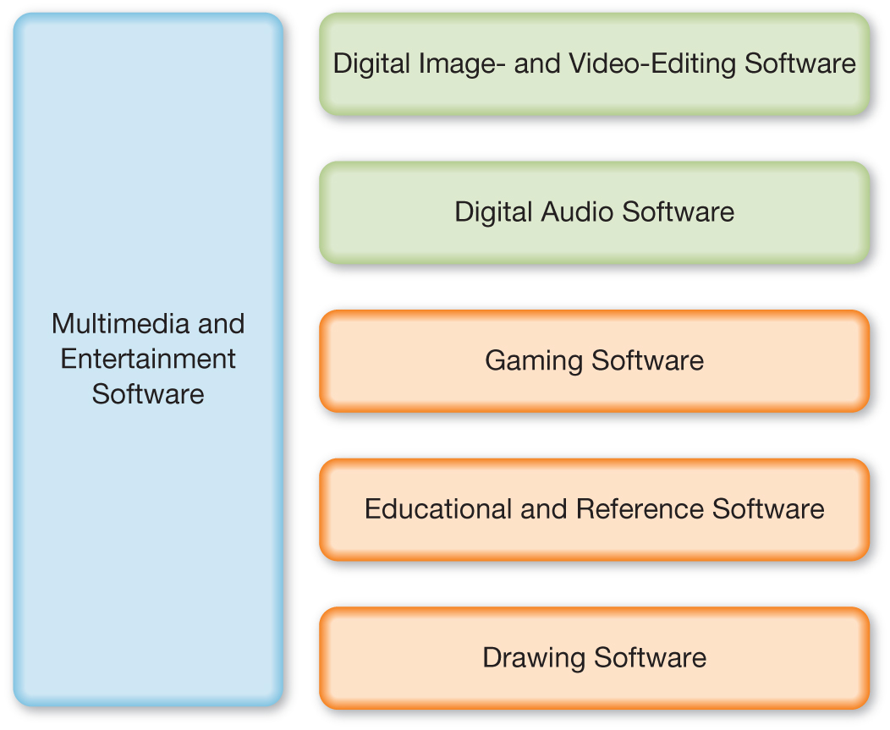
Multimedia and Entertainment Software
Notes:
Multimedia software includes digital image- and video-editing software, digital audio software, and other specialty software required to produce computer games, animations, and movies.

Slide 34
Multimedia and Entertainment Software: Digital Image- and Video-Editing Software
Image-editing software
Edit photographs and other images
Notes:
One great advantage of taking digital images is that you can easily manipulate them and then share them on the web. Facebook is a great option for sharing images, but Flickr (flickr.com) is a website specifically for sharing photos.
If you want to edit your photos before sharing, Adobe Photoshop Elements is image-editing software geared to the casual photographer. Image-editing software includes tools for basic modifications to digital photos such as removing red-eye; modifying contrast, sharpness, and color casts; or removing scratches or rips from scanned images of old photos.

Slide 35
Multimedia and Entertainment Software: Digital Image- and Video-Editing Software (cont.)
Examples
Adobe Photoshop Elements
Google Picasa
Online photo-sharing and photo-storing sites
Notes:
Google Picasa (picasa.google.com) is a popular application that not only lets you edit images but also helps to organize and share your digital images. Picasa also stores your photos on the web.
Several other online photo-sharing and photo-storing sites, such as Snapfish (snapfish.com), Kodak (Kodak.com), and Shutterfly (shutterfly.com), let you upload your digital images from your computer, create photo albums, and share them with friends and family. These sites offer printing services as well, letting you create customized cards, stationary, books, and even iPhone cases with your images.

Slide 36
Multimedia and Entertainment Software: Digital Image- and Video-Editing software (cont.)
Professional image editors might use:
Adobe Photoshop
Corel PaintShop Photo Pro
GIMP
Notes:
Adobe Photoshop and Corel PaintShop Photo Pro are fully featured image-editing applications. GIMP (gimpshop.com) is a free download that has most of the features offered by the for-pay applications. Photoshop and PaintShop Photo Pro each offer sophisticated tools for tasks like layering images and masking images (hiding parts of layers to create effects such as collages).
Designers use these more sophisticated tools to create the enhanced digital images used commercially in logos in advertisements, and on book and CD covers.

Slide 37
Multimedia and Entertainment Software: Digital Image- and Video-Editing software (cont.)
Video-editing software
Refine videos
Examples
Adobe Premiere Pro and Apple’s Final Cut Pro
Windows Movie Maker and iMovie
Notes:
It’s easy to upload videos directly to YouTube or Facebook unedited, but you can use digital video-editing software to help refine your videos.
Although the most expensive products (such as Adobe Premiere Pro and Apple’s Final Cut Pro) offer the widest range of special effects and tools, some moderately priced video-editing programs have enough features to keep the casual user happy. Windows Movie Maker and iMovie have intuitive drag-and-drop features that make it simple to create professional-quality movies with little or no training.

Slide 38
Multimedia and Entertainment Software: Digital Audio Software
Digital audio files
Downloaded music files, audiobooks, or podcasts
Compressed
Uncompressed
Notes:
You probably have a variety of digital audio files stored on your computer, such as downloaded music files, audiobooks, or podcasts. These type of audio files have been compressed so they’re more manageable to transfer to and from your computer and over the Internet.
You might also see uncompressed audio files on your computers. Uncompressed files—the files found on audio CDs, for example—have not had any data removed, so the quality is high and the files size is large.
Compressed formats remove data that the human ear does not hear to make the files smaller.

Slide 39
Multimedia and Entertainment Software: Digital Audio Software (cont.)
Create and record audio files
MAGIX Music Maker
Apple GarageBand
Audacity
Cakewalk SONAR
AudioAcrobat
Notes:
There are many digital audio applications that let you create and record your own audio files. With programs such as MAGIX Music Maker or Apple GarageBand, you can compose your own songs or soundtracks with virtual instruments, voice recorders, synthesizers, and special audio effects, and these will end up as uncompressed MIDI files. Other programs, such as Audacity and Cakewalk SONAR, let you record audio files.

Slide 40
Multimedia and Entertainment Software: Digital Audio Software (cont.)
Audio-editing software
Notes:
Audio-editing software includes tools that make editing audio files as easy as editing text files. Software such as the open source Audacity (audacity.sourceforge.net) and Sony Sound Forge Pro 10 (sonycreativesoftware.com) lets you perform such basic editing tasks as cutting dead air space from the beginning or end of a song or clipping a portion from the middle.
AudioAcrobat (audioacrobat.com), a web-based program, makes it easy to record and stream audio and video and hosts your audio files. These applications support recording sound files from a microphone or any source you can connect through the input line of a sound card.

Slide 41
Multimedia and Entertainment Software: Gaming Software
Create characters to extend a game
EverQuest
Oblivion
Unreal Tournament
Notes:
Now that video games represent an industry with revenue of more than $25 billion each year, designing and creating video games is emerging as a desirable career opportunity. Professionally created video games involve artistic storytelling and design, as well as sophisticated programming. Major production houses such as Electronic Arts use applications not easily available to the casual home enthusiast.
However, you can use the editors and game engines available for games such as EverQuest, Oblivion, and Unreal Tournament to create custom levels of characters to extend the game.

Slide 42
Multimedia and Entertainment Software: Gaming Software (cont.)
Create your own games
Unity
Adobe Flash
RPG Maker VK
GameMaker
Notes:
If you want to try your hand at creating your own video games, multimedia applications such as Unity, Adobe Flash, and RPG Maker VX provide the tools you need to explore game design and creation. The program GameMaker (yoyogames.com) is a free product that lets you build a game without any programming; you drag and drop key elements of the new game creation into place. Alice (alice.org) is another free environment to check out; it lets you easily create 3-D animations and simple games.

Slide 43
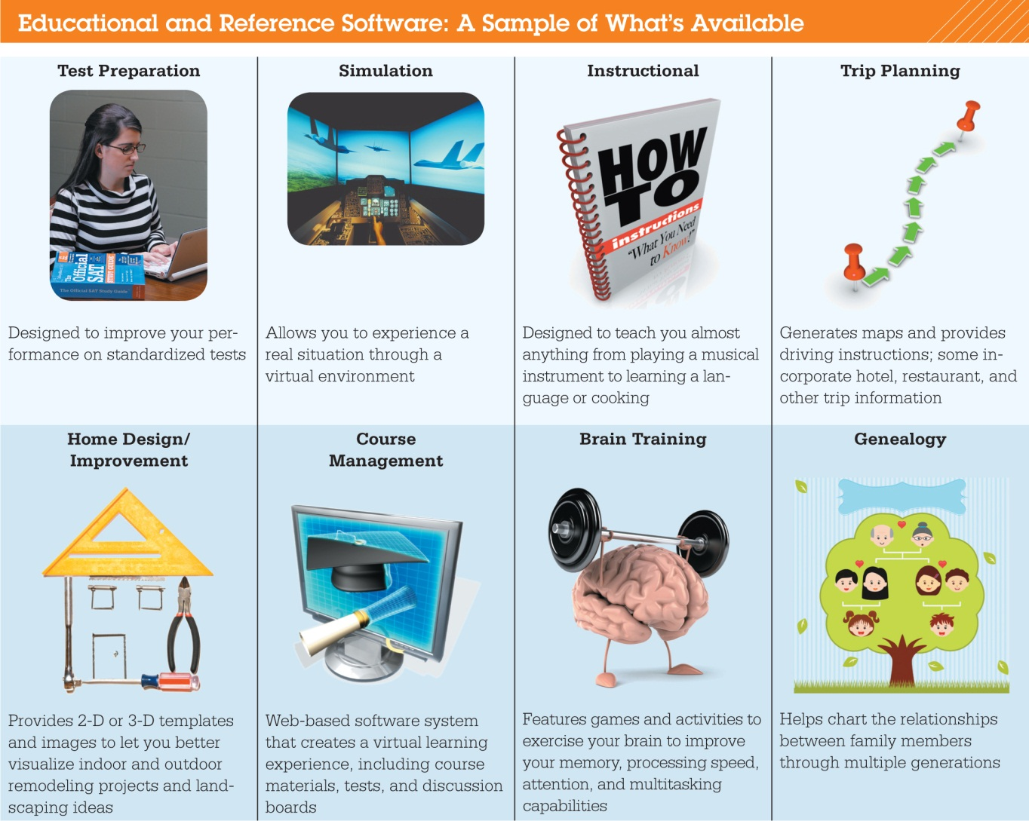
Multimedia and Entertainment Software: Educational and Reference Software
Notes:
Educational and reference software is available to help you master, study, design, create, or plan. There are software products that teach new skills such as typing, languages, and playing the guitar.
Students who will be taking standardized tests often use test preparation software.
Many computer and online brain-training games and programs are designed to improve the health and function of your brain. Lumosity (lumosity.com) is one example that has a specific “workout” program that you can play on your PC or smartphone. Brain Age² (brainage.com) has software for the Nintendo DS and is designed for players of all ages.

Slide 44
Multimedia and Entertainment Software: Educational and Reference Software (cont.)
Tutorials for computer applications
Simulation programs
Notes:
Many programs provide tutorials for popular computer applications. These programs use illustrated systematic instructions to guide users through unfamiliar skills in an environment that acts like the actual software, without the software actually being installed.
Some training programs, known as simulation programs, allow you to experience or control the software as if it were the actual software or an actual event. Such simulation programs include commercial and military flight training, surgical instrument training, and machine operation training.

Slide 45
Multimedia and Entertainment Software: Educational and Reference Software (cont.)
Course management software
Online classes
Examples
Blackboard
Moodle
Angel
Notes:
Although some courses are run from an individually developed website, many online courses are run using course management software such as Blackboard, Moodle, and Angel. In addition to traditional classroom tools such as calendars and grade books, these programs provide special areas for students and instructors to exchange ideas and information through chat rooms, discussion forums, and e-mail.

Slide 46
Multimedia and Entertainment Software: Educational and Reference Software (cont.)
Collaboration tools
Virtual office hours
Examples
Whiteboards
Desktop sharing
Notes:
In addition, collaboration tools such as whiteboards and desktop sharing facilitate virtual office hour sessions.
Depending on the content and course materials, you might need a password or special plug-ins to view certain videos or demos.

Slide 47
Multimedia and Entertainment Software: Drawing Software
Create:
Two-dimensional, line-based drawings
Technical diagrams
Animations
Professional-level
Adobe Illustrator
Home and landscape planning
Notes:
Drawing software (or illustration software) lets you create or edit 2-D, line-based drawings. You can use it to create technical diagrams or original nonphotographic drawings, animations, and illustrations using tools such as pens, pencils, and paintbrushes.
Adobe Illustrator includes tools that let you create professional-quality creative and technical illustrations.
There are many software packages to help plan the layout of homes and landscapes, such as those offered by Broderbund. A simple, web-based, and fairly full-featured free 3-D modeling application is Trimble’s SketchUp. SketchUp (sketchup.com) lets you create a 3-D image of your dream house.

Slide 48
Managing Your Software: Getting Software
Students
Educational discount
Campus computer stores
College bookstores
Online software suppliers
Notes:
If you’re a student, you can sometimes buy substantially discounted software that is no different from regularly priced software. Campus computer stores and college bookstores offer discounted prices to students who possess a valid student ID. Online software suppliers such as Journey Education Marketing (journeyed.com) and Academic Superstore (academicsuperstore.com) also offer popular software to students at reduced prices.

Slide 49
Managing Your Software: Getting Software (cont.)
Open source
Beta versions
Still under development
Notes:
In addition to open source software, discussed previously in the chapter, freeware is copyrighted software that you can use for free. Explore sites like FileHippo (filehippo.com) and MajorGeeks (majorgreeks.com) to see how many good freeware programs are available. However, although much legitimate freeware exists, some unscrupulous people use freeware to distribute viruses and malware.
Some software developers offer beta versions of their software free of charge. A beta version is an application that is still under development. By distributing free beta versions, developers hope users will report errors, or bugs, they find in their programs.

Slide 50
Managing Your Software: Software Licenses
End User License Agreement (EULA)
States the following:
Ultimate owner of software
Whether copies can be made
Number of installations allowed
Warranties
Notes:
A software license, also known as an End User License Agreement (EULA), is an agreement between you, the user, and the software company. You accept this agreement before installing the software on your machine. It’s a legal contract that outlines the acceptable uses of the program and any actions that violate the agreement.
Generally, the agreement states who the ultimate owner of the software is, under what circumstances copies of the software can be made, and whether the software can be installed on any other machine. Finally, the license agreement will state what, if any, warranty comes with the software.

Slide 51
Managing Your Software: Software Licenses (cont.)
Single License
Multiuser licenses might be available
Notes:
Some software is purchased with a single license to cover one person’s specific use. You cannot share these licenses, and you can’t “extend” the license to install the software on more than one of your computers. Many manufacturers are offering family licensing deals to include several computers in one household.
Businesses and educational institutions often buy multiuser licenses that allow more than one person to use the software. Some multiuser licenses are per-seat and limit the number of users overall, whereas others, called concurrent licenses, limit the number of users accessing the software at any given time.

Slide 52
Managing Your Software: Software Licenses (cont.)
Open source software
Free software license
GNU
Copyleft
Notes:
Anyone using open source software has access to the program’s code. Therefore, open source software programs can be tweaked by another user and redistributed.
A free software license, the GNU General Public License, is required and grants the recipients the right to modify and redistribute the software. Without such a license, the recipient would be in violation of the copyright laws. This concept of redistributing modified open source software under the same terms as the original software is known as copyleft. Thus, all enhancements, additions, and other changes to copyleft software must also be distributed as free software.

Slide 53
Managing Your Software: Getting the Right Software for Your System
Software programs have sets of system requirements
Upgrade
Notes:
Every software program has a set of system requirements that specify the minimum recommended standards for the operating system, processor, primary memory (random access memory, or RAM), and hard drive capacity.
These requirements are printed on the software packaging or are available at the manufacturer’s website.
Periodically, software developers improve the functionality of their software by releasing a software upgrade. Although software developers suggest otherwise, there’s no need to rush out and buy the latest version of a software program every time one is available.

Slide 54
Managing Your Software: Getting the Right Software for Your System
Update
Backward-compatible
Notes:
In between upgrades, developers will make available software updates (sometimes referred to as software patches). Updates are usually downloaded and provide smaller enhancements to the software or fix program bugs.
Vendors make new versions of software backward-compatible, meaning that they can recognize (open) files created with older versions. However, some software programs are not forward-compatible, so these older versions are not able to recognize files created on newer versions of the same software.

Slide 55
Managing Your Software: Installing and Uninstalling Software
DVD or downloading from the Internet
Full installation
Custom installation
Notes:
Before you use most software, you must install it on your system. The installation process will differ slightly depending on how you are installing it.
One of the first steps in the installation wizard asks you to decide between a full installation and a custom installation. A full installation (or typical installation) copies all the most commonly used files and programs from the distribution disc to your computer’s hard drive.
By selecting custom installation, you can decide which features you want installed on your hard drive. Installing only the features you want saves space on your hard drive.

Slide 56
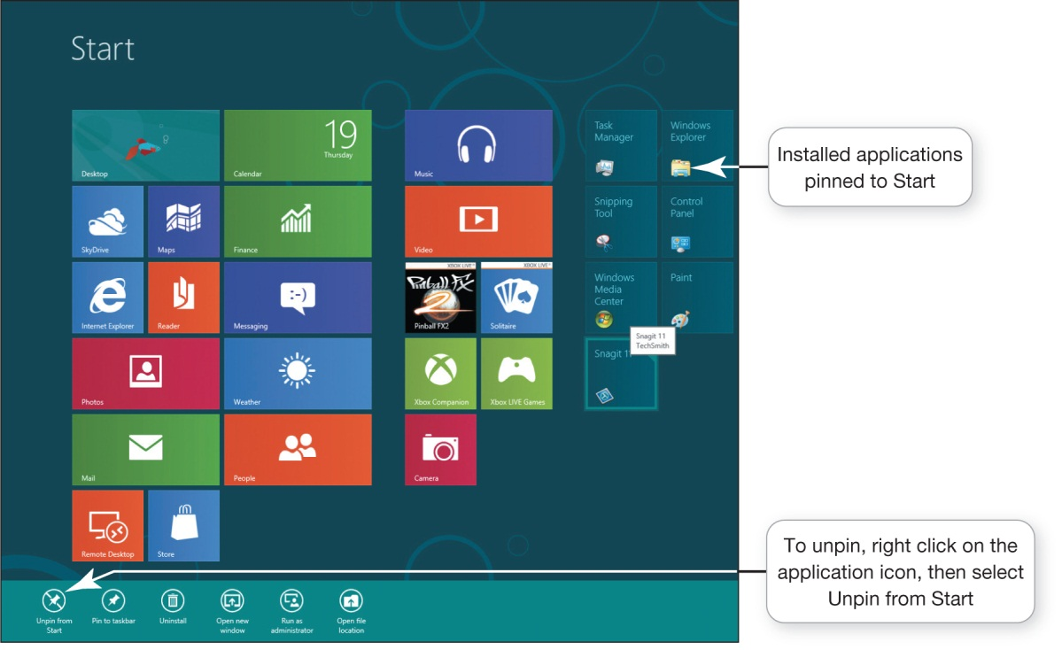
Managing Your Software: Installing and Uninstalling Software (cont.)
Windows
Uninstalling software
Notes:
Every program you install on your system gets a tile on the Start screen.
You can work from the desktop view in Windows 8. You can pin a shortcut to a program on the taskbar or to the Start screen.
Windows 8 makes it easy to uninstall a program: Simply right-click the program icon on the Start screen, then click Uninstall. To uninstall a program from the desktop view, right-click on the program, select Programs from the Control Panel, then click Uninstall. Select the program you want to uninstall from the list, then click Uninstall.

Slide 57
Managing Your Software: Installing and Uninstalling Software (cont.)
Recovering from a computer crash
Notes:
Although some preinstalled software is not necessary to replace if your computer crashes, other software such as the operating system is critical to reinstall. Most manufacturers use a separate partition on the hard drive to hold an image, or copy, of the preinstalled software. However, it’s not always possible to reboot from the partitioned hard drive, especially when your computer crashes, so one of the first things you should do after you purchase a new computer is create a system repair disc.

Slide 58
Managing Your Software: Installing and Uninstalling Software (cont.)
Recovery utility
Notes:
Generally, the manufacturer will have placed a utility on your system, or you can use the Recovery utility included in Windows to create a repair drive or disc.
You can access the Recovery utility in Windows 8 from the Control Panel by typing Recovery in the search box, and then clicking Create a recovery drive under System. Then, to create the repair drive, insert a blank flash drive in a USB port (or you can choose use a DVD) and follow the steps in the wizard. Once the copy has been made, label the flash drive or DVD and put it away in a safe place.

Slide 59
Chapter 4 Summary Questions
What’s the difference between application software and system software?
Notes:
Software is a set of instructions that tells the computer what to do. Application software is the software you use to do everyday tasks at home, school, and work. Application software includes the following:
Productivity software
Business software
Multimedia software
Educational and reference software
System software is the software that helps run the computer and coordinates instructions between application software and the computer’s hardware devices. System software includes the operating system and utility programs.

Slide 60
Chapter 4 Summary Questions
What are the different ways I can access and use software?
Notes:
Some software comes preinstalled on your computer. You will need to add other software by installing or accessing the software from the web.
There are two types of software that you can install:
Proprietary software is software you buy.
Open source software is program code that is free and publicly available with few licensing and copyright restrictions.
Web-based applications are those that are hosted online by the vendor and made available to the customer over the Internet. This web-based distribution model is also referred to as Software as a Service (SaaS).

Slide 61
Chapter 4 Summary Questions
What kinds of applications are included in productivity software?
Notes:
Productivity software programs include the following:
Word processing: to create and edit written documents
Spreadsheet: to do calculations and numerical and what-if analyses easily
Presentation: to create slide presentations
Database: to store and organize data
Note-taking: to take notes and easily organize and search them
Personal information manager (PIM): to keep you organized by putting a calendar, address book, notepad, and to-do lists within your computer
Individuals can also use productivity software to help with business-like tasks such as managing personal finances and preparing taxes.

Slide 62
Chapter 4 Summary Questions
What kinds of software do small and large businesses use?
Notes:
Businesses use software to help them with the following tasks:
Finances and accounting
Desktop publishing
Web page authoring
Project management
Customer relationship management (CRM)
Enterprise resource planning (ERP)
E-commerce
Businesses may use specialized business software (or vertical market software) that is designed for their specific industry. Some businesses also use specialized drawing software to create technical drawings and computer-aided design (CAD) software to create 3-D models.

Slide 63
Chapter 4 Summary Questions
What types of multimedia and entertainment software are available?
Notes:
Multimedia software is for playing, copying, recording, editing, and organizing multimedia files. Multimedia software includes:
Digital image- and video-editing software
Digital audio software
Specialty software to produce computer games
Educational and reference software is available to help you master, study, design, create, or plan.
Simulation programs let users experience or control the software as if it were the actual software or event.
Course management software provides traditional classroom tools over the Internet.
Drawing software includes a wide range of software programs that help you create and edit simple line-based drawings or create more-complex designs for both imaginative and technical illustrations.

Slide 64
Chapter 4 Summary Questions
What’s important to know when buying software?
Notes:
You must purchase software unless it is freeware or open source. When you purchase software, you’re actually purchasing the license to use it and therefore must abide by the terms of the licensing agreement you accept when installing the program. Before installing software on your computer, ensure that your system setup meets the system requirements that specify the minimum recommended standards for the operating system, processor, primary memory (RAM), and hard drive capacity. Sometimes, there are other specifications for the video card, monitor, optical drive, and other peripherals.

Slide 65
Chapter 4 Summary Questions
How do I install and uninstall software?
Notes:
When installing software, you are often given the choice between a full or custom installation.
It’s best to use the uninstall feature that comes with the operating system.
In Windows 8, right-click on the program tile on the Start screen, then select Uninstall from the bottom tab that displays.
Using the uninstall feature of the operating system will help you ensure that all additional program files are removed.

Slide 66

All rights reserved. No part of this publication may be reproduced, stored in a retrieval system, or transmitted, in any form or by any means, electronic, mechanical, photocopying, recording, or otherwise, without the prior written permission of the publisher. Printed in the United States of America.
Copyright © 2015 Pearson Education, Inc.

